Slide 1
Web Design Lecture-2C
Instructor: Vishal Chawla

Slide 2
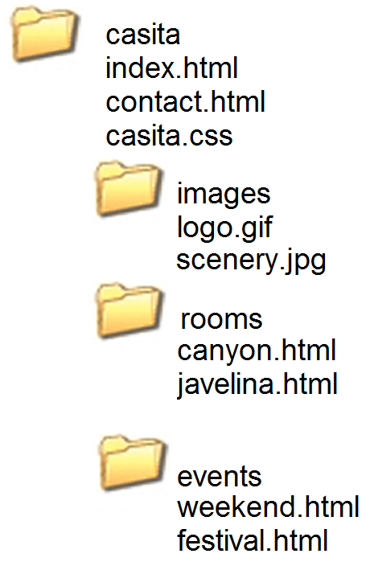
More on Relative Linking
Relative links from the canyon.html page in the rooms folder
<a href="javelina.html">Javelina</a>
<a href="../index.html">Home</a>
<a href="../events/weekend.html">Weekend Events</a>
Source: Basics of Web Design (HTML5 and CSS3)
Notes:
8.1 student files

Slide 3
Linking to Fragment Identifiers
A link to a part of a web page
Also called named fragments, fragment ids
Two components:
The element that identifies the named fragment of a Web page. This requires the id attribute.
<div id="top"> ….. </div>
2. The anchor tag that links to the named fragment of a Web page. This uses the href attribute. <a href="#top">Back to Top</a>
Note the use of the # in the anchor tag!
Source: Basics of Web Design (HTML5 and CSS3)
Notes:
8.2 student files

Slide 4
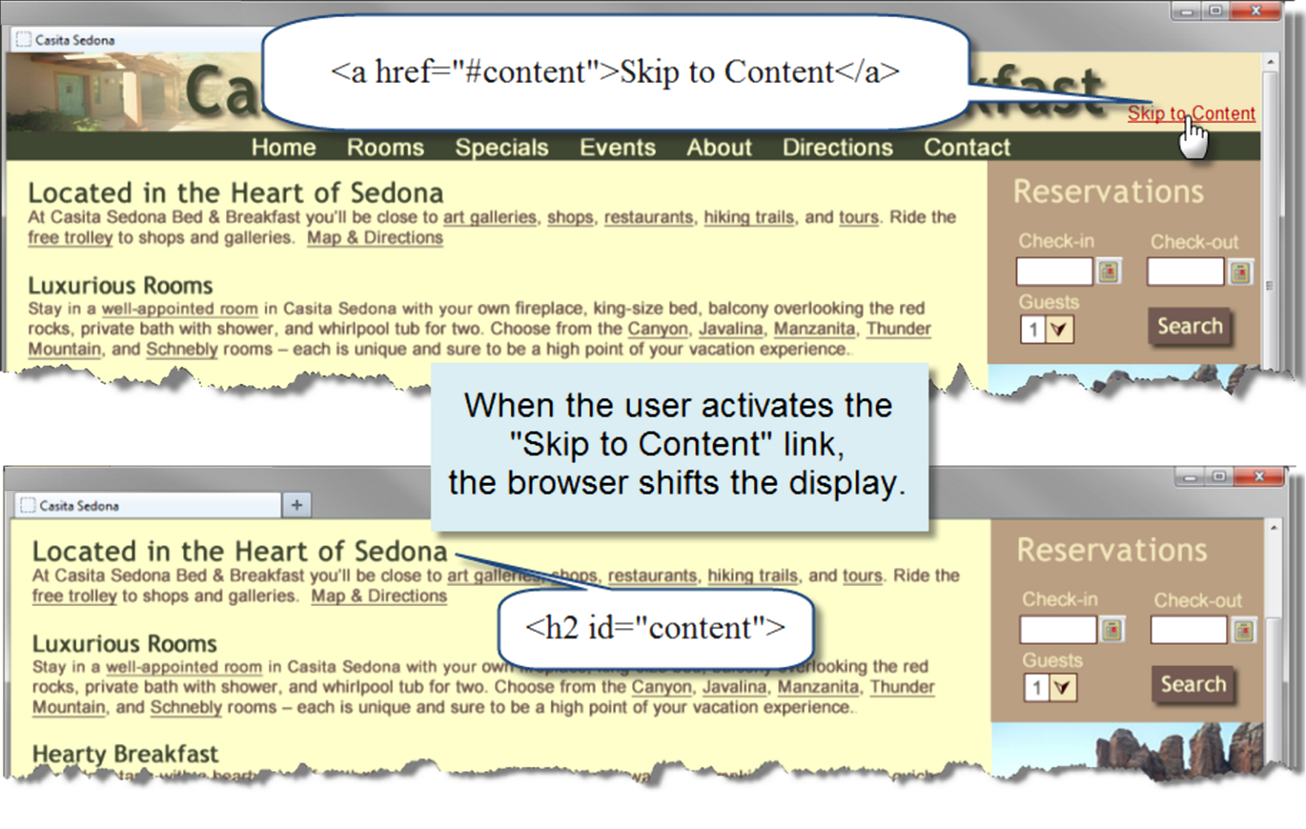
Skip to Content
Source: Basics of Web Design (HTML5 and CSS3)

Slide 5
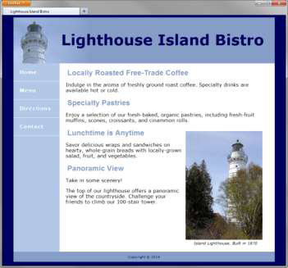
HTML5 Figure and Figcaption Elements
<figure>
<img src="lighthouseisland.jpg" width="250" height="355" alt="Lighthouse Island">
<figcaption> Island Lighthouse, Built in 1870 </figcaption>
</figure>
Source: Basics of Web Design (HTML5 and CSS3)
Notes:
Student files 8.3

Slide 6
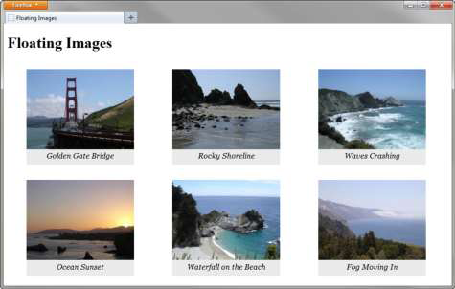
Floating Images
HTML:
<figure>
<img src="photo1.jpg" alt="Golden Gate Bridge" width="225" height="168">
<figcaption>Golden Gate Bridge</figcaption>
</figure>
CSS
figure { float: left; width: 230px; padding-bottom: 10px; background-color: #EAEAEA; }
figcaption { text-align: center; font-style: italic; font-family: Georgia, serif; }
Source: Basics of Web Design (HTML5 and CSS3)

Slide 7
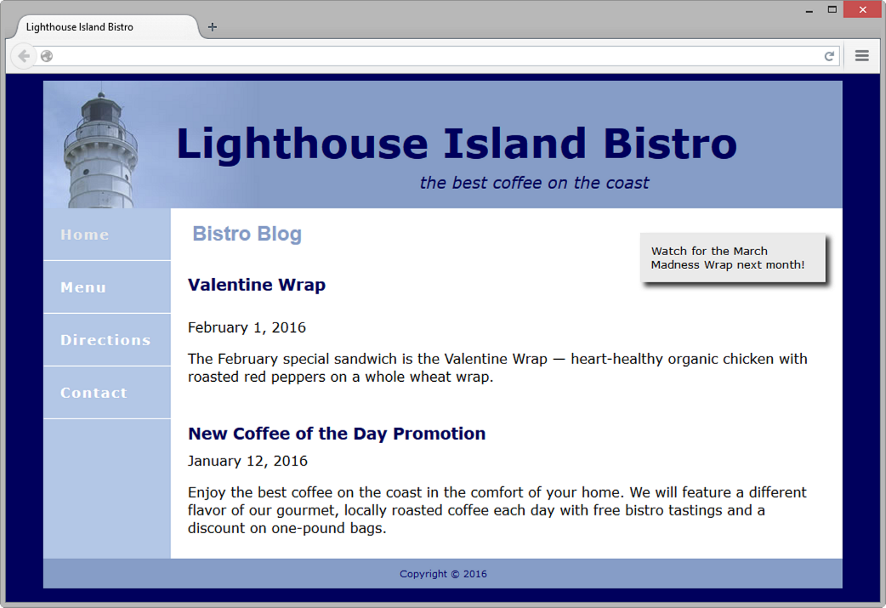
More HTML5 Elements
Section Element
indicates a portion or “section” of a document, like a chapter or topic
Article Element
indicates an independent entry, like a blog posting, that can stand on its own
Aside Element
indicates a sidebar or other tangential content
Time Element
represents a date or time
Source: Basics of Web Design (HTML5 and CSS3)
Notes:
Student file 8.5

Slide 8
HTML5 Compatibility with Older Browsers
CSS
header, main, nav, footer, section, article, figure, figcaption, aside { display: block; }
HTML5 Shim (aka HTML5 Shiv)
<!--[if lt IE 9]>
<script src=" http://html5shim.googlecode.com/svn/trunk/html5.js"> </script>
<![endif]-->
Source: Basics of Web Design (HTML5 and CSS3)

Slide 9
CSS Styling for Print
Create an external style sheet with the configurations for browser display.
Create a second external style sheet with the configurations for printing.
Connect both of the external style sheets to the web page using two <link > elements.
<link rel="stylesheet" href="lighthouse.css" media="screen">
<link rel="stylesheet" href="lighthouseprint.css" media="print">
Source: Basics of Web Design (HTML5 and CSS3)

Slide 10
Print Styling Best Practices
Hide non-essential content Example:
nav { display: none; }
Configure font size and color for printing
Use pt font sizes, use dark text color
Control page breaks
Example: .newpage { page-break-before: always; }
Source: Basics of Web Design (HTML5 and CSS3)
Notes:
Student file 8.7

Slide 11

Mobile Web Design Best Practices
Three Approaches to Mobile Web:
Develop a new mobile site with a .mobi TLD
Create a separate website hosted within your current domain targeted for mobile users
Use CSS to configure your current website for display on both mobile and desktop devices
Source: Basics of Web Design (HTML5 and CSS3)

Slide 12
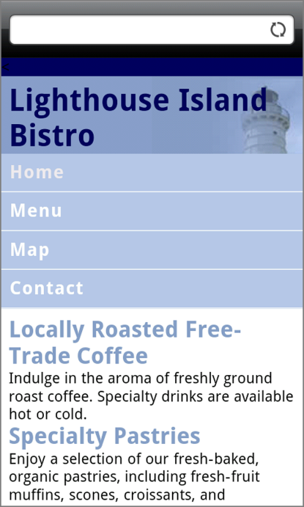
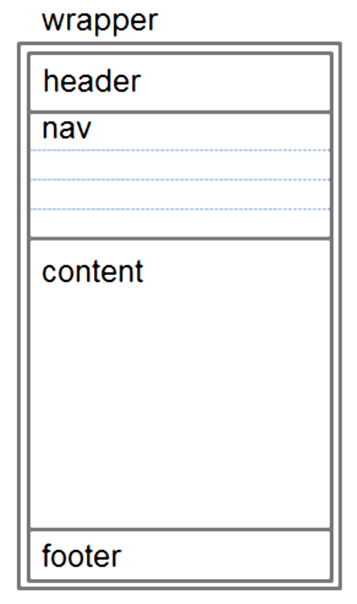
Design Techniques for Mobile Web
Single column design
Avoid floats, tables, frames
Descriptive page title
Descriptive headings
Optimize images
Descriptive alt text for images
Eliminate unneeded images
Navigation in lists
Em or percentage font size units
Common font typefaces
Good contrast between text and background colors
Provide “Skip to Content” hyperlink
Provide “Back to Top” hyperlink
Notice the overlap between these techniques and designing to provide for accessibility?
Source: Basics of Web Design (HTML5 and CSS3)

Slide 13
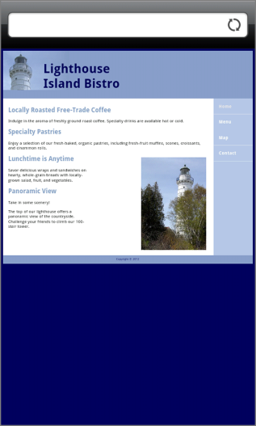
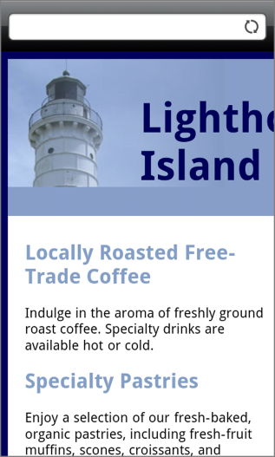
Viewport Meta Tag
Default action for most mobile devices is to zoom out and scale the web page
Viewport Meta Tag
Created as an Apple extension to configure display on mobile devices
Configures width and initial scale of browser viewport
<meta name="viewport" content="width=device-width, initial-scale=1.0">
Source: Basics of Web Design (HTML5 and CSS3)

Slide 14

Telephone & Text Message Hyperlinks
Telephone Scheme
<a href="tel:888-555-5555">Call 888-555-5555</a>
Many mobile browsers will initiate a phone call when the hyperlink is clicked.
SMS Scheme
<a href="sms:888-555-5555">Text 888-555-5555</a>
Many mobile browsers will initiate a text message to the phone number when the hyperlink is clicked.
Source: Basics of Web Design (HTML5 and CSS3)

Slide 15
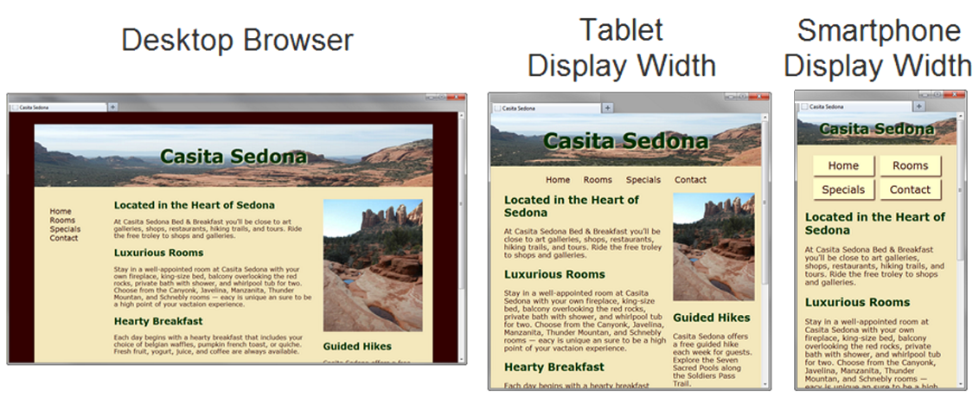
Responsive Web Design
Term coined by Ethan Marcotte
Progressively enhancing a web page for different viewing contexts
Techniques:
Fluid Layout
CSS3 Media Queries
Flexible Images
Source: Basics of Web Design (HTML5 and CSS3)

Slide 16
CSS3 Media Queries
Media Query
Determines the capability of the mobile device, such as screen resolution
Directs the browser to styles configured specifically for those capabilities
Link Element Example:
<link href="lighthousemobile.css" media="only screen and (max-device-width: 480px)">
CSS Example:
@media only screen and (max-width: 480px) {
header { background-image: url(mobile.gif);
}
}
Source: Basics of Web Design (HTML5 and CSS3)

Slide 17
Flexible Images
Edit HTML: remove height and width attributes
CSS:
img { max-width: 100%;
height: auto; }
Source: Basics of Web Design (HTML5 and CSS3)

